Slide 1
Data Handling
Lies, damned lies and statistics

Slide 2
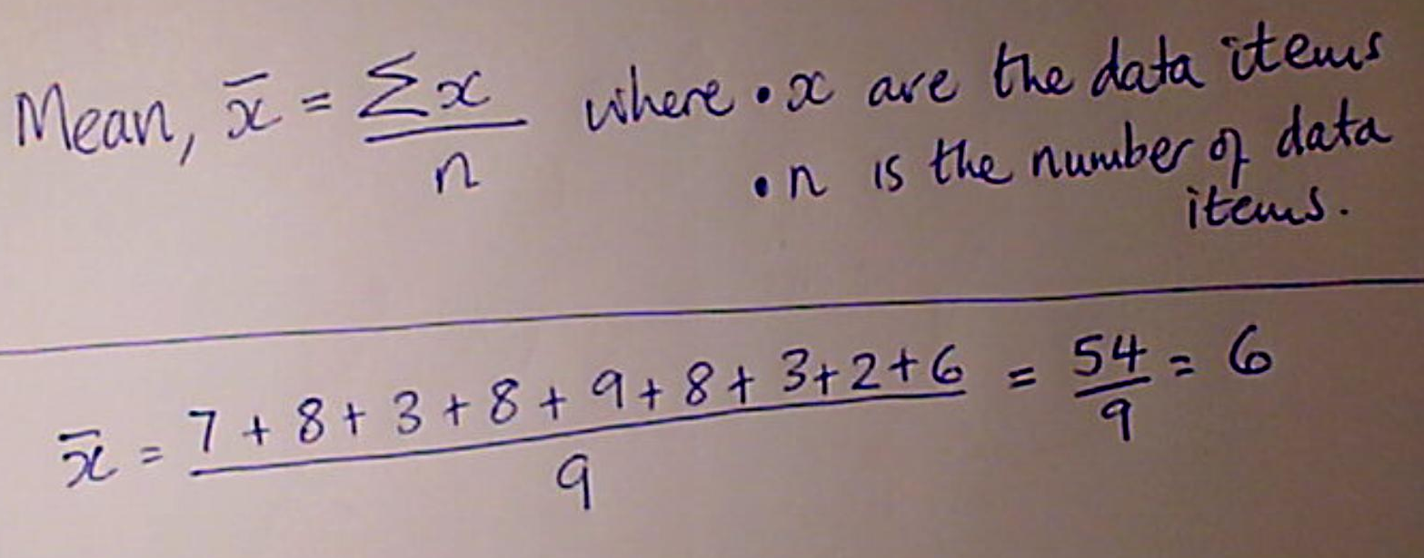
Knowledge Review
Work out the mean, median and mode of the following:
7, 8, 3, 8, 9, 8, 3, 2, 6

Slide 3
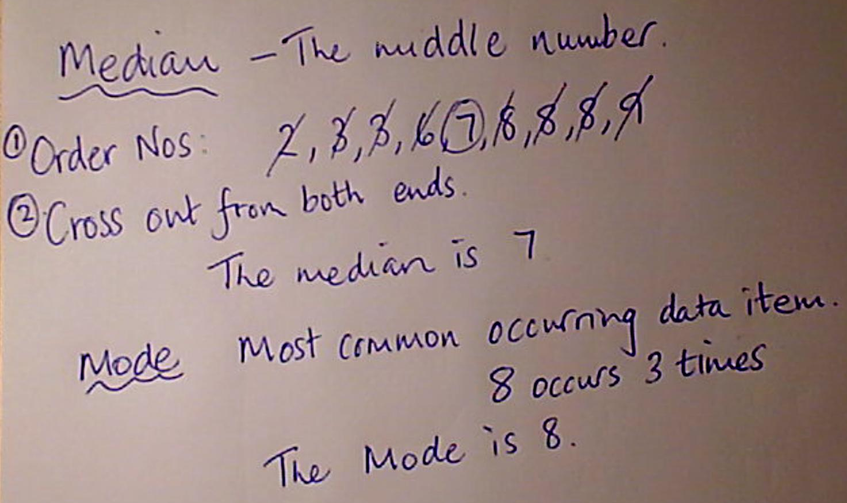
Median and Mode

Slide 4
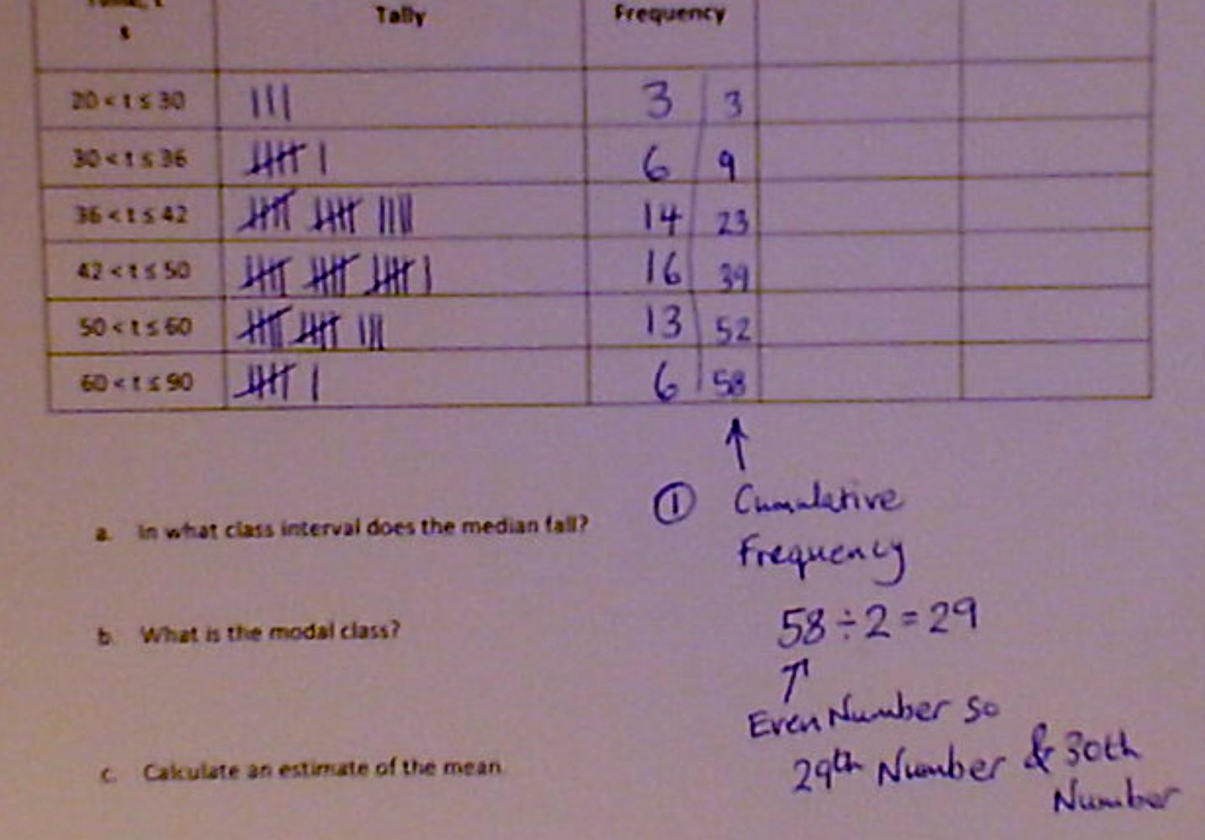
In what class interval does the median fall?

Slide 5
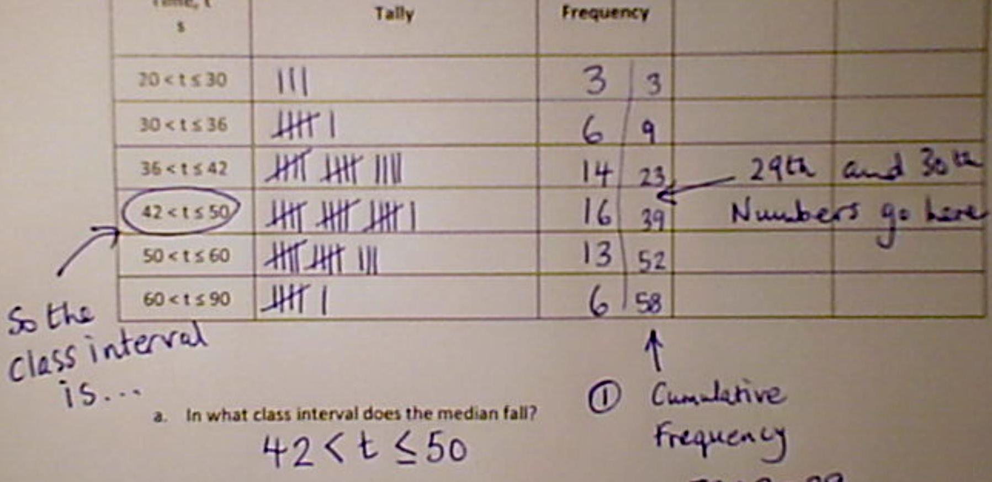
In what class interval does the median fall?

Slide 6
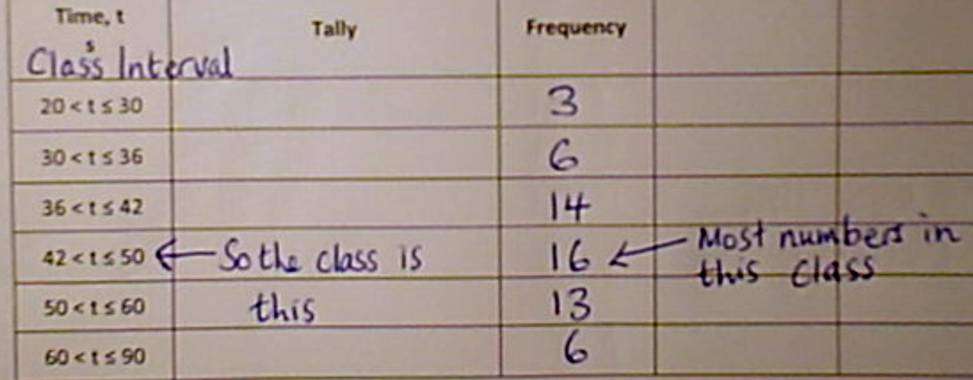
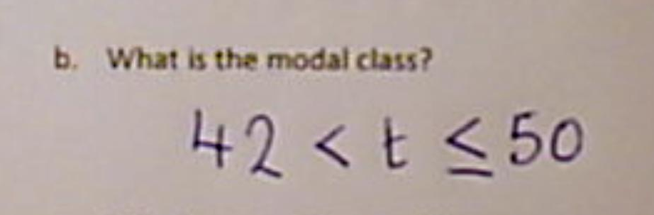
What is the modal class?

Slide 7
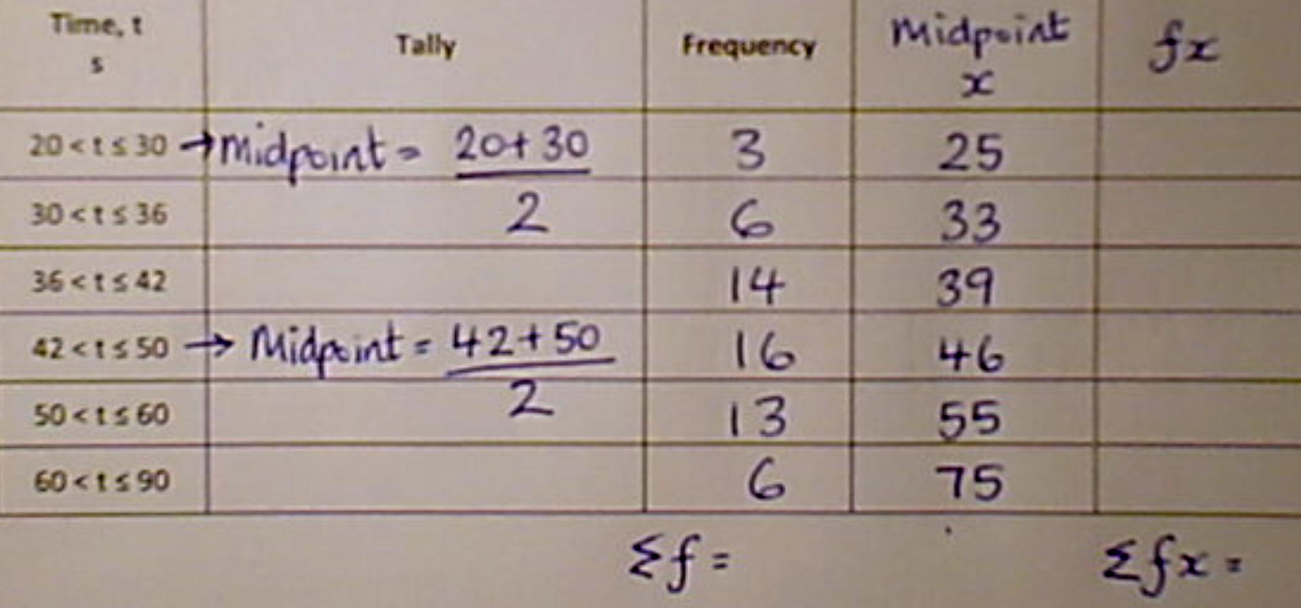
Calculate an estimate of the mean.

Slide 8
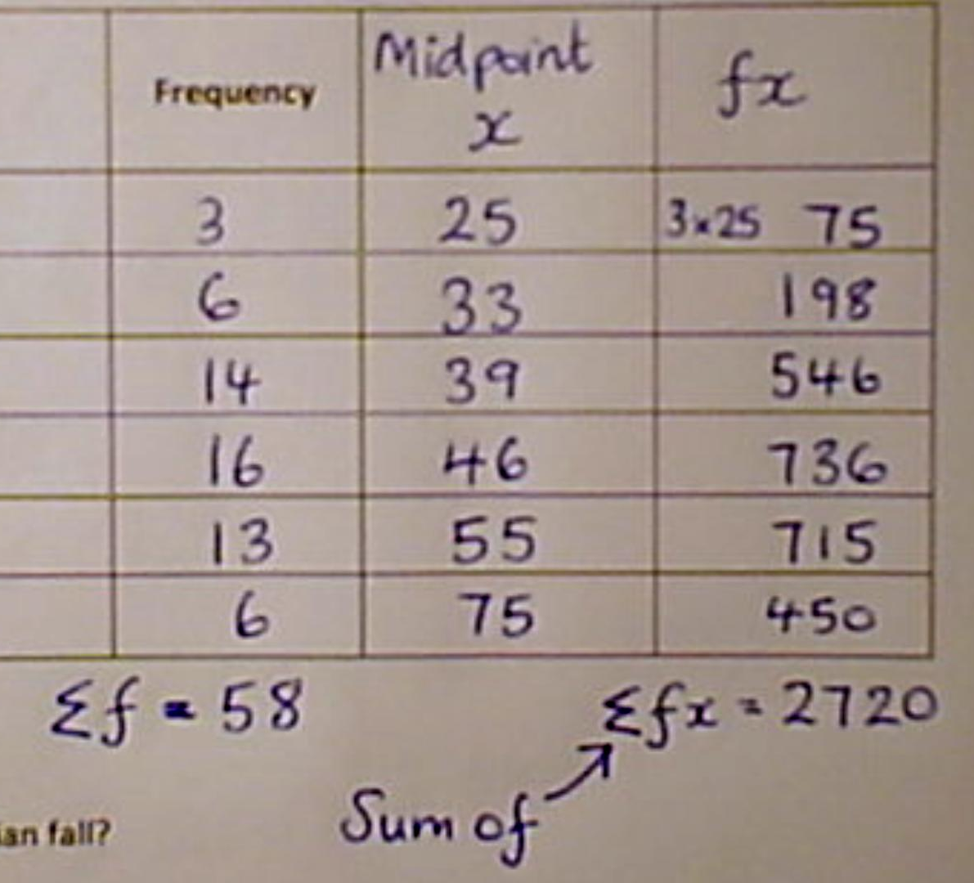
Calculate an estimate of the mean.

Slide 9
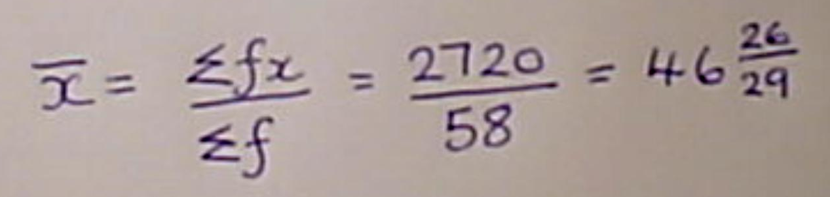
Calculate an estimate of the mean.

Slide 10
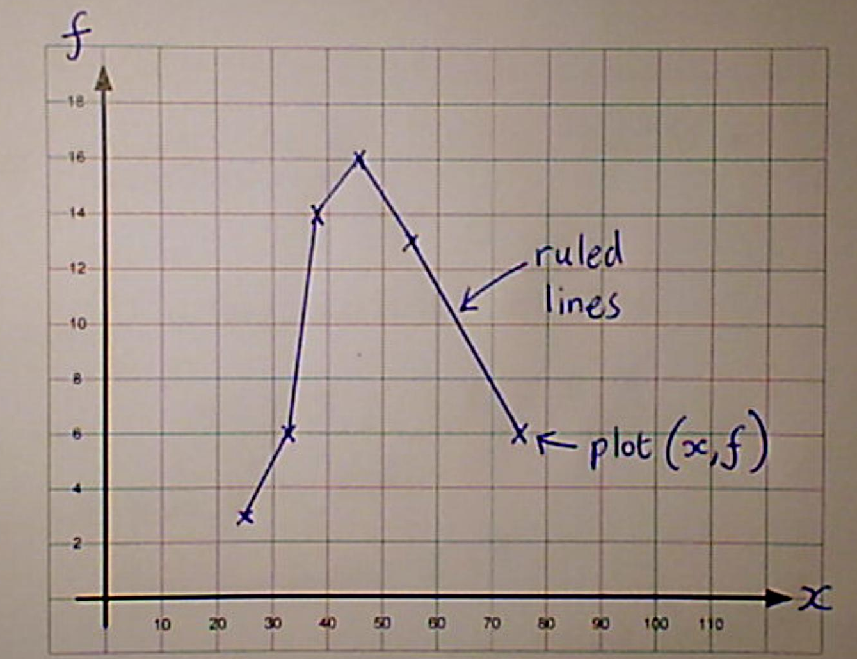
Draw a frequency polygon of the data in the table

Slide 11

Mean $Mean, \overline{x}= \frac{\sum{x}}{n}$
Set A : 43.7
Set B: 50.6
Set C: 46.5
Set D: 46.4

Slide 12
Mode Most common occurring
Set A : 43
Set B: 49
Set C: 39
Set D: 43

Slide 13
Median Central data item
Set A : 43
Set B: 48
Set C: 45
Set D: 43

Slide 14
Range is maximum - minimum
Set A : 45
Set B: 60
Set C: 67
Set D: 69

Slide 15
Interquartile Range
Set A : 14.75
Set B: 17.75
Set C: 15.75
Set D: 13.75

Slide 16
Box Plot A

Slide 17
Box Plot B

Slide 18
Box Plot C

Slide 19
Box Plot D

